Slide 1

Selected 2 Project

Slide 2
Content
Architecture used in the Paper
Dataset details
Implementation details
Results and visualizations

Slide 3

Architecture used in the Paper

Slide 4
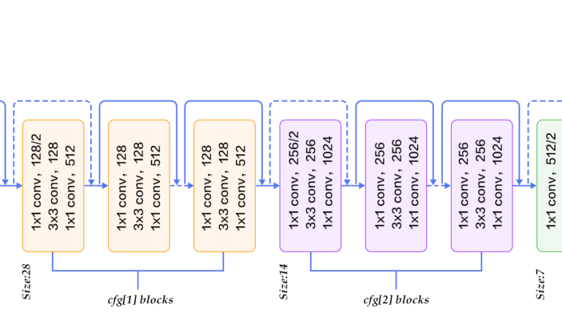
Resnet-50

Slide 5
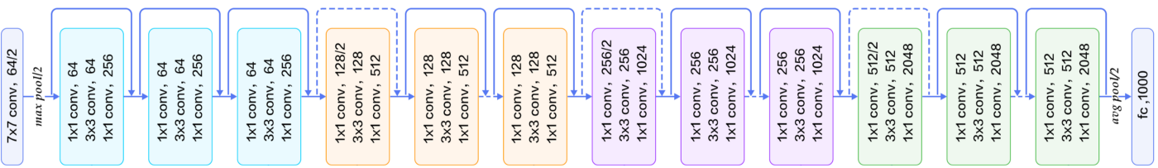
Resnet-50
Model trained on ImageNet Dataset

Slide 6
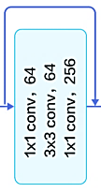
x
Avoid vanishing gradient problem
x
Output = f(X) + X

Slide 7
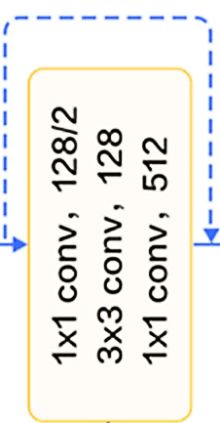
x
Avoid vanishing gradient problem
x
Output = f(X) + X
Conv(X)
Because
Input shape != output shape

Slide 8


Dataset details

Slide 9

🌸|Flowers
The dataset contains images of 16 different flowers species.
Total number of Images: 15740
(239 MB)

Slide 10
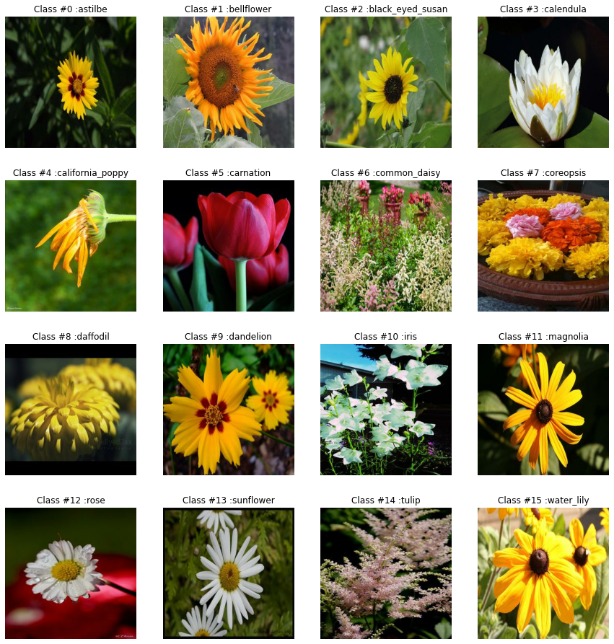
Images samples

Slide 11
Data balancing
Class #0 (Number Of Images: 737 ) Name : astilbe
Class #1 (Number Of Images: 873 ) Name : bellflower
Class #2 (Number Of Images: 1000) Name : black_eyed_susan
Class #3 (Number Of Images: 978 ) Name : calendula
Class #4 (Number Of Images: 1022) Name : california_poppy
Class #5 (Number Of Images: 923 ) Name : carnation
Class #6 (Number Of Images: 980 ) Name : common_daisy
Class #7 (Number Of Images: 1047) Name : coreopsis
Class #8 (Number Of Images: 970 ) Name : daffodil
Class #9 (Number Of Images: 1052) Name : dandelion
Class #10 (Number Of Images: 1054) Name : iris
Class #11 (Number Of Images: 1048) Name : magnolia
Class #12 (Number Of Images: 999 ) Name : rose
Class #13 (Number Of Images: 1027) Name : sunflower
Class #14 (Number Of Images: 1048) Name : tulip
Class #15 (Number Of Images: 982 ) Name : water_lily

Slide 12
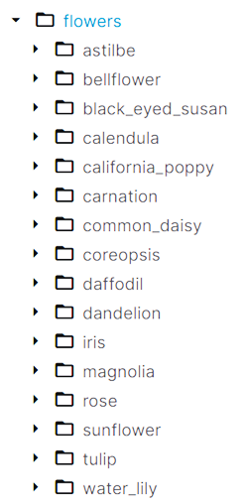
Folder structure

Slide 13

Implementation details

Slide 14
Data Preproccesing
Resize Images to (128px,128px)
Training Data: 72%
Validation Data: 18%
Loading the Images with colors (RGB)
Testing Data: 10%

Slide 15
Hyper parameters
Hyper parameters | Model before optimization | Model after optimization
Pretrained model | ResNet50 | ResNet50
weights | ImageNet | ImageNet
Pooling | max | average
Top layers | Dense(32, activation='tanh’) Dense(16, activation='softmax') | Dense(160, activation='relu') Dense(16, activation='softmax')
epochs | 4 | 7

Slide 16

Results and visualizations

Slide 17
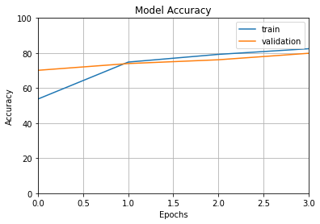
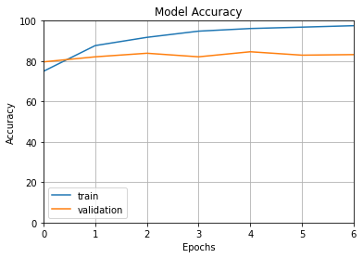
Before Optimization
After Optimization
Training Accuracy: 82.4%
Validation Accuracy: 79%
Testing Accuracy: 80%
Training Accuracy: 97.5%
Validation Accuracy: 83%
Testing Accuracy: 85%

